Slide 1
Program name
Repl.it or Ideone.com Repository Link:
File to mark:https://ideone.com/OHUhSF
⚠ The 🕷️ debugging and 📋testing slides are required to pass the assessment.

Slide 2
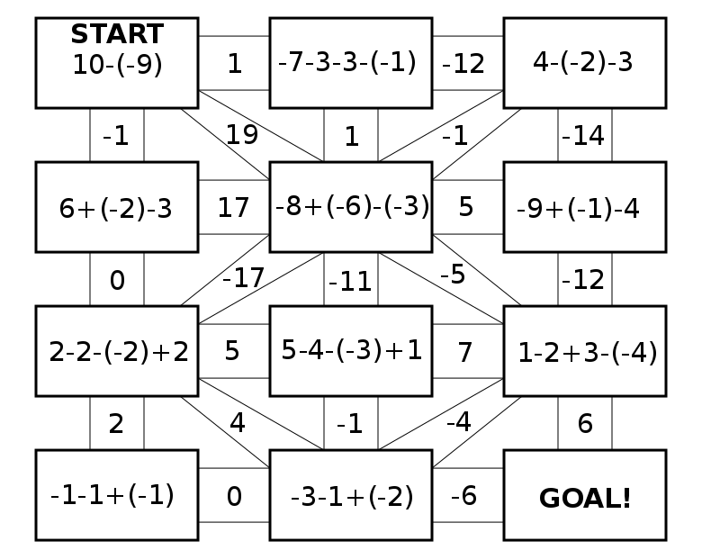
Planning (not directly assessed)
Plan is to make a maze like on the right without diagonals
Other things to add.
Make the size of the maze changeable currently hard coded.
Add the maths part of the maze.
I’m aware my testing is very small but due to the lack or major moments or user intervention I don’t know how else I would add more.

Slide 3
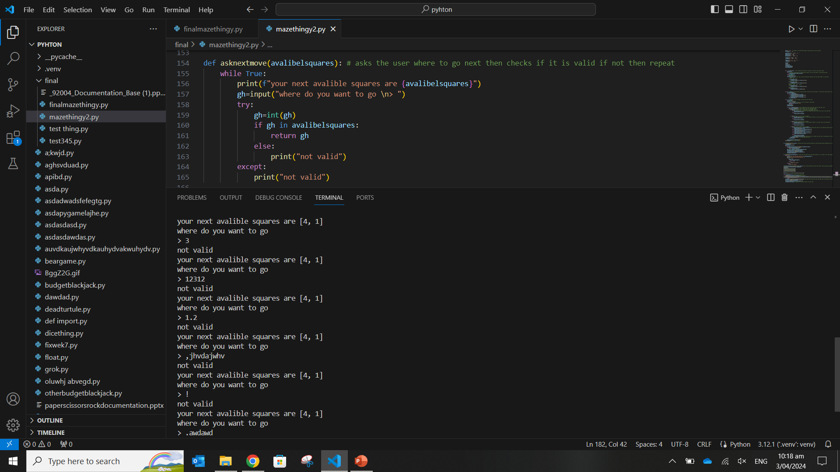
📋 Test Plan Template ask the user for there place
Test Case | Expected Values
Correct options, given the nature of options these are also therefore boundary cases | Expected values are to print the maze again this time with the changes made then ask again. Due to the large number of possibilities the following are some potential cases.
Weird and other wrong options | Print not valid and loop

Slide 4
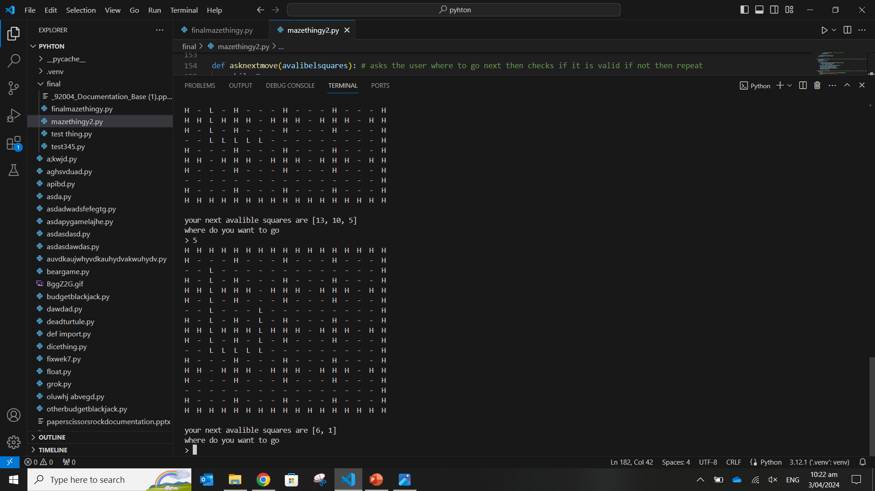
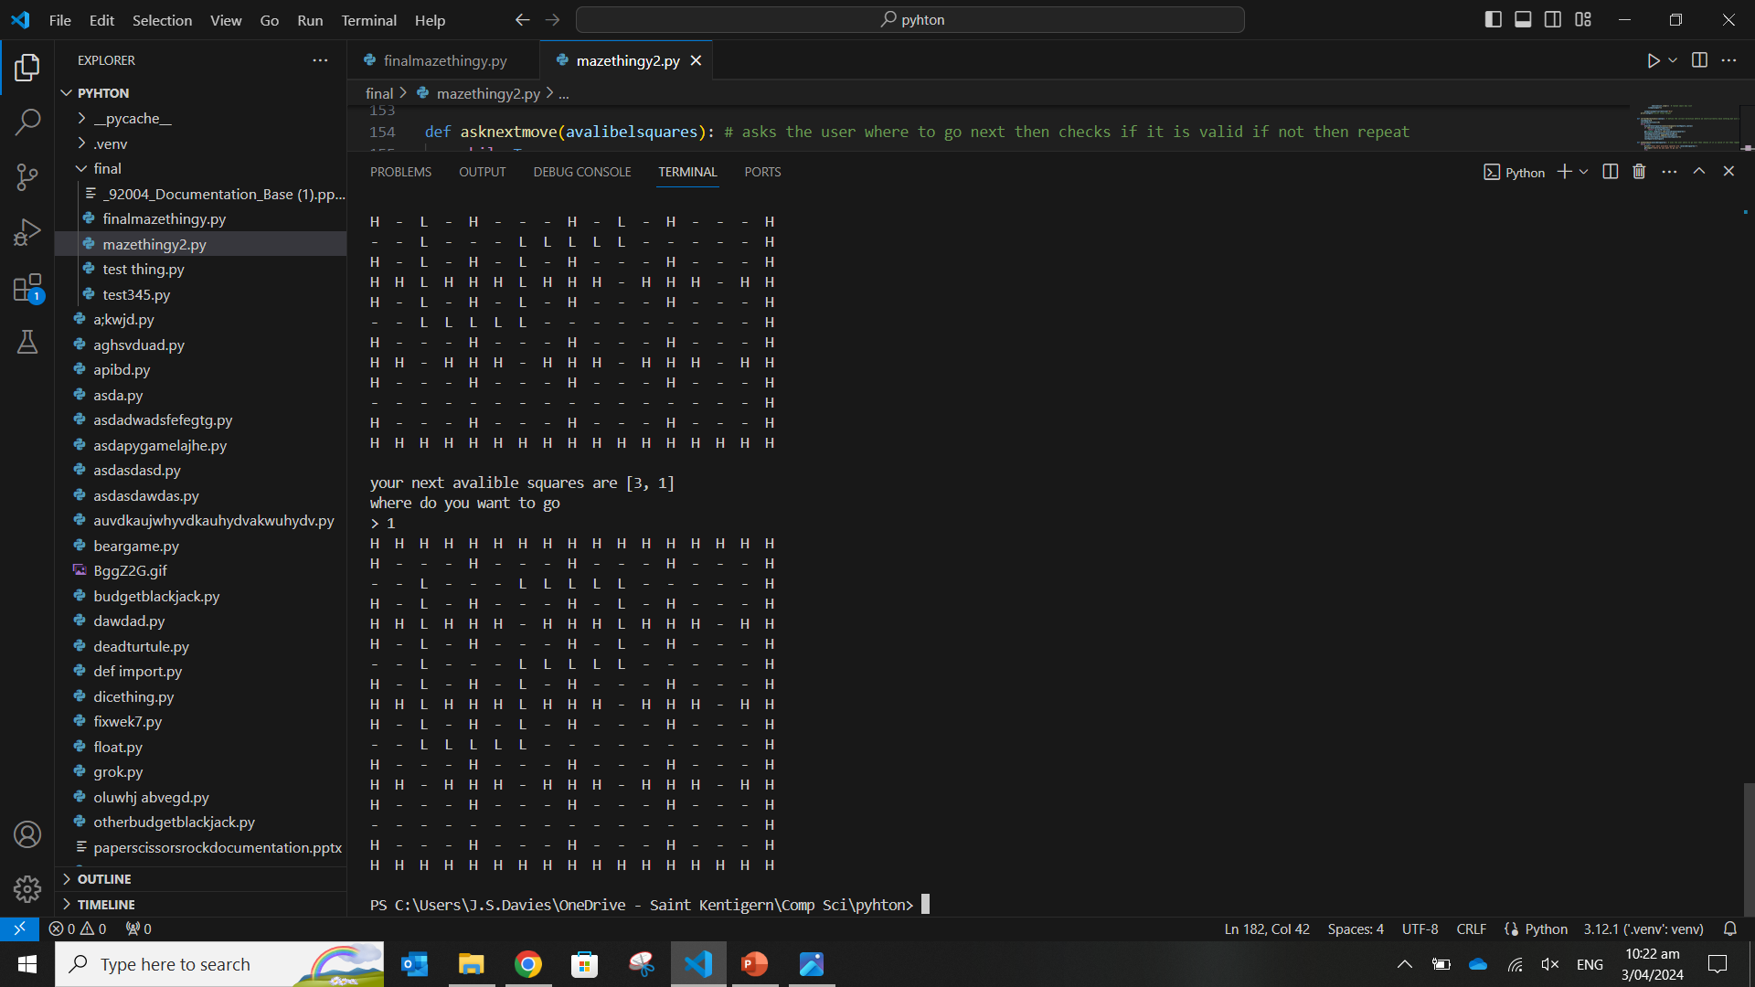

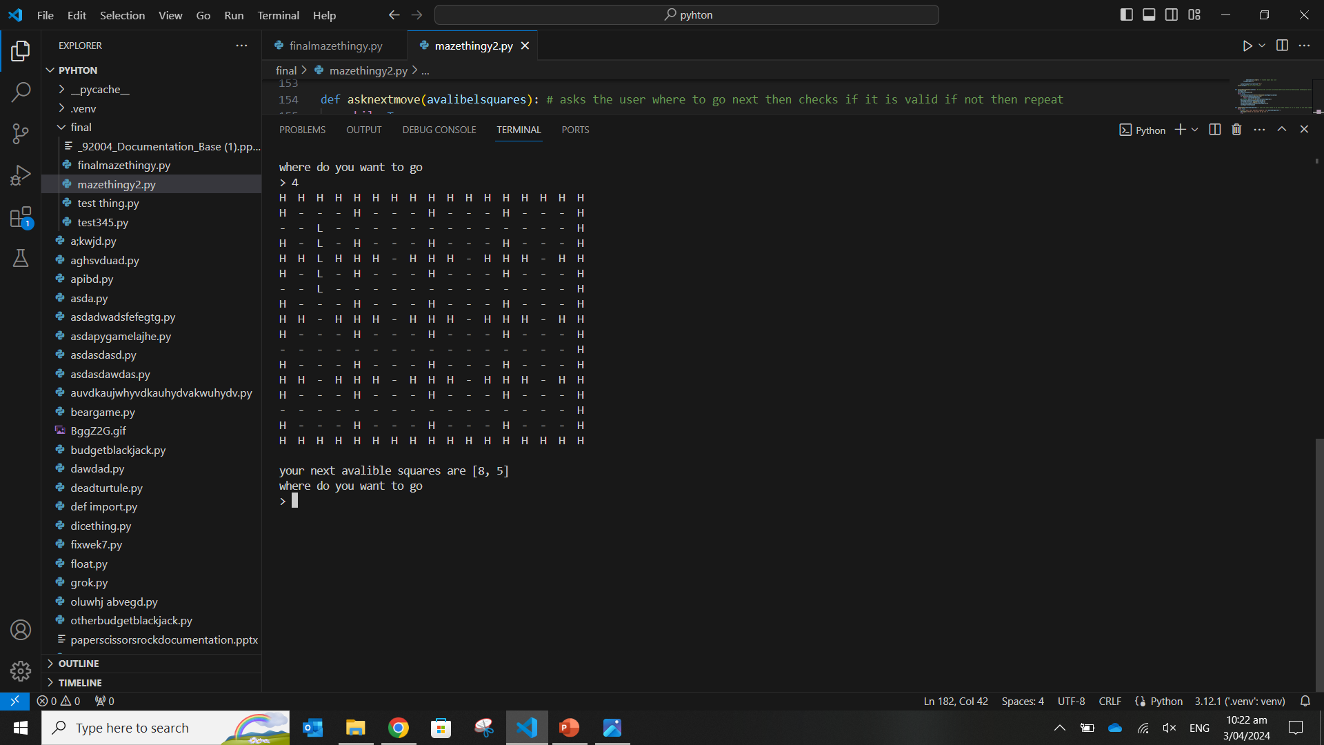

Slide 5
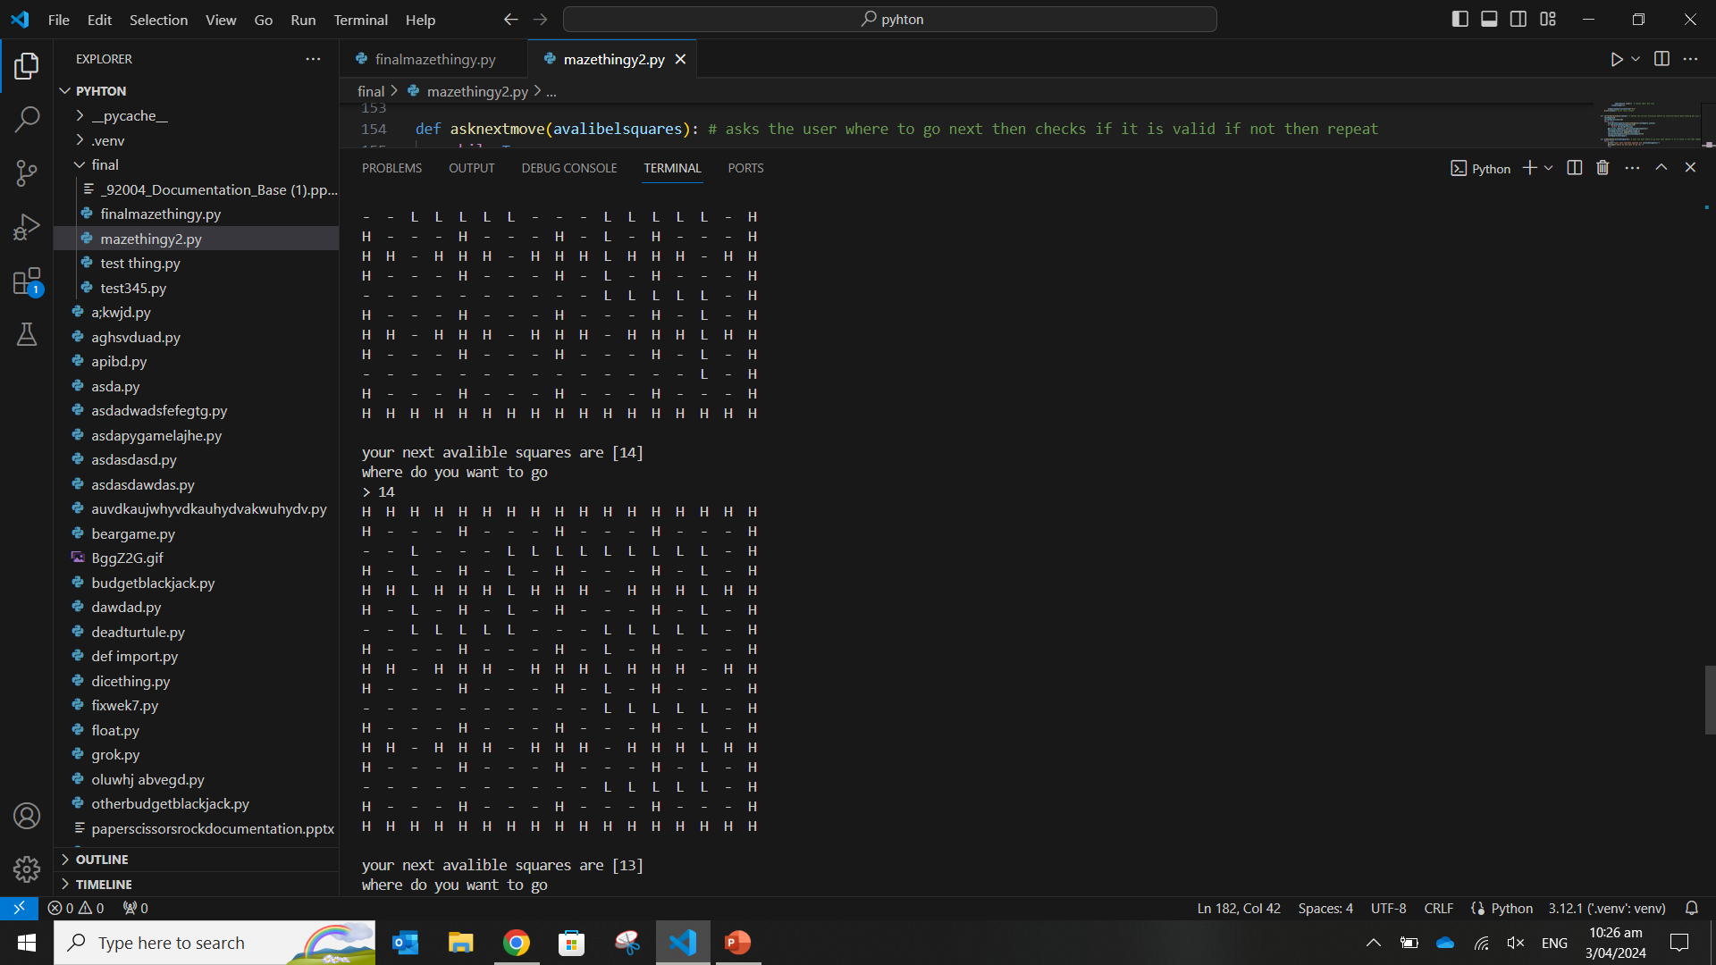

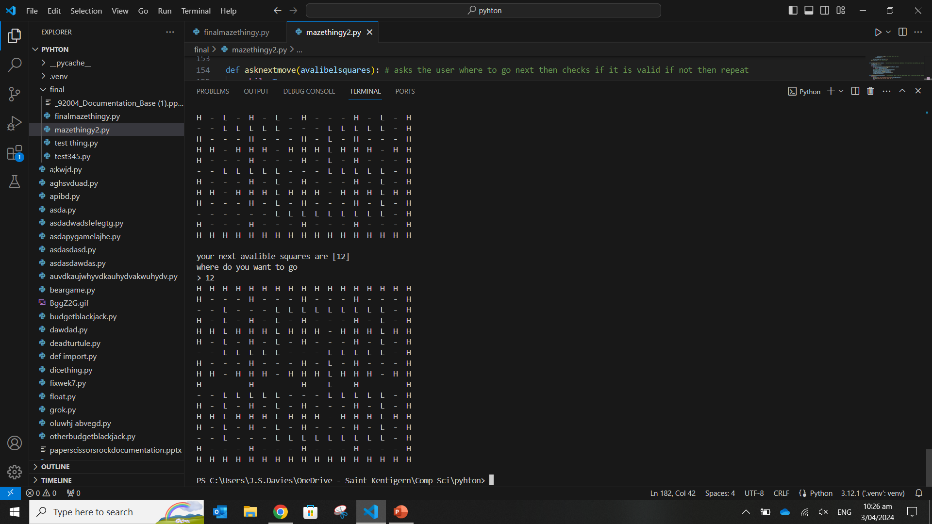
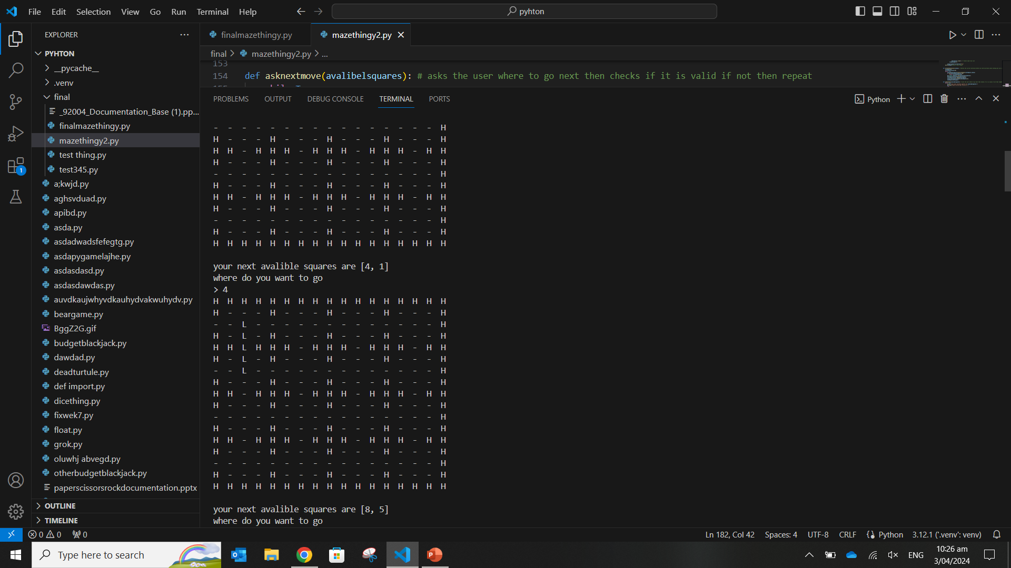

Slide 6
📋 Test Plan Template <<DUPLICATE ME>>
Test Case | Expected Values

Slide 7
🕷️ Debugging Slide <<DUPLICATE ME>>
Replace this text with a brief explanation of what you did. Remember to include screenshots of the broken and fixed code (we only need the lines that you changed).

